Slide 1
Survey of Side-Channel Vulnerabilities for Short-Range Wireless Communication Technologies
Dr. Shannon Beck, Dr. Manohar Raavi, Caleb Dale, Kaija Weishalla, Brennan Worrell

Slide 2
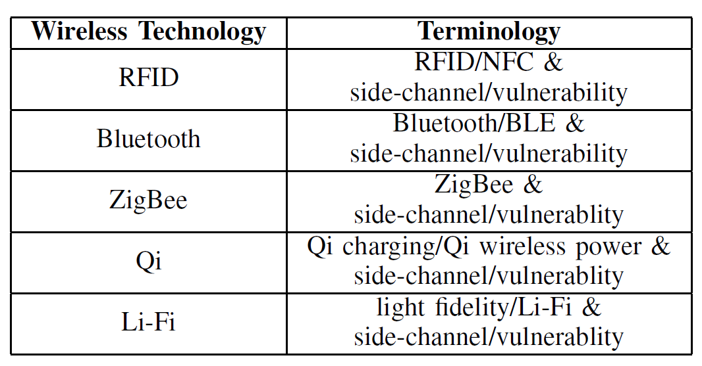
Survey Paper Outline
Motivation
Side Channels
For each protocol:
Description
Vulnerabilities
Mitigations
Protocols discussed:
RFID
Bluetooth
ZigBee
Qi
Li-Fi
Conclusion

Slide 3
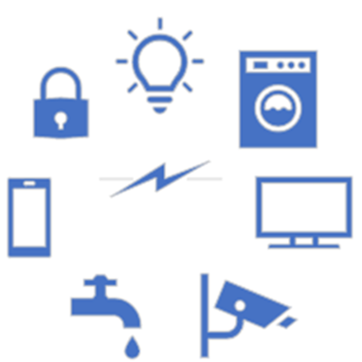
Motivation
Undergraduate research
Support background knowledge of wireless power charging capstone
First larger-scale paper
Skills focus:
Research
Discussion of source credibility
Use and integrate knowledge from across various source types: papers, cybersecurity blogs, CVEs, standards documents
Citation work
Gain knowledge of research area
Peer review and feedback

Slide 4
Side Channels
Side Channel:
Gain information by analyzing unintended outputs or behaviors instead of directly accessing the system itself
Exploit physical characteristics of system rather than directly targeting its cryptographic algorithms or software vulnerabilities.
EM spectrum for paper, exception of Li-Fi with light spectrum

Slide 5
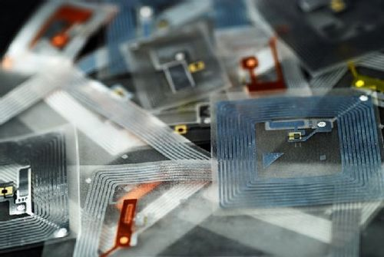

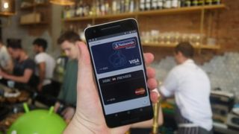
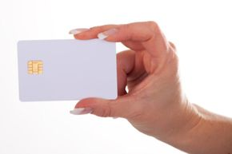
RFID / NFC
Notes:
Tags / card: https://electronics.howstuffworks.com/near-field-communication.htm
Book: https://www.leghorngroup.com/rfid-labels-for-books/

Slide 6
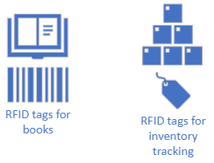
RFID
Radio Frequency Identification
Uses microchip tags and scanners to enable
device identification and tracking
Close range wireless communication, includes NFC
Uses include:
medical equipment [48], inventory [49] and supply chain management [50], credit cards [51]
Widely used, users require confidence
Transmit sensitive information (passports, credit cards, physical access etc.)

Slide 7
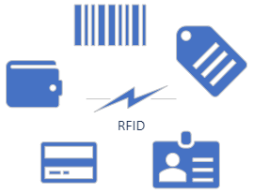
RFID Vulnerabilities
Attacks and Mitigations:
Tear-off attack – physical security
Eavesdrop / skim (within 10 cm) - use encryption [7][9]
Cloning - Detect duplicate (cloned) or counterfeit RFID tags [11]
Incorrect use of cryptography
General mitigations: Cybersecurity best practices
Implement secure key management practices to protect the cryptographic keys
Conduct regular security audits
Install firmware and software updates to address known vulnerabilities
Notes:
Correct use of cryptography algorithms, such as the 128-bit AES cipher with randomization enabled is a commonly-used practice to counteract side-channel attacks [7], [9]. Detection of duplicate (cloned) or counterfeit RFID tags [11]. Cyber best practices apply here: implement secure key management practices to protect the cryptographic keys, conduct regular security audits, and install firmware and software updates to address known vulnerabilities

Slide 8
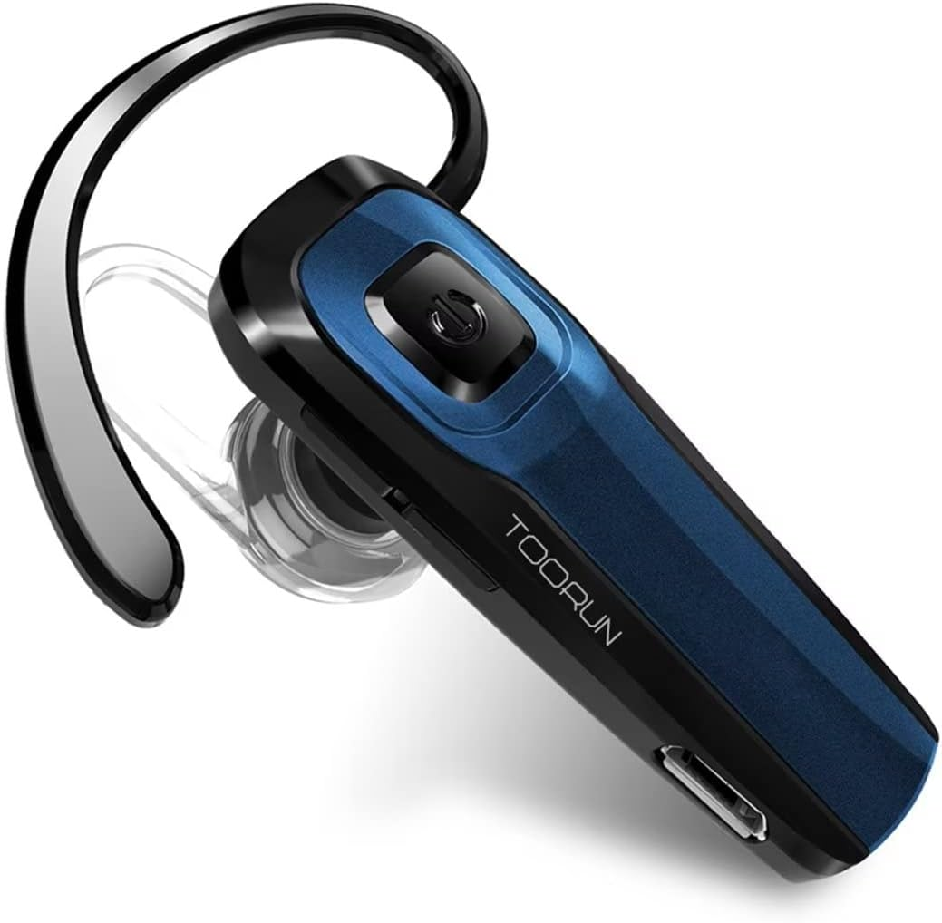
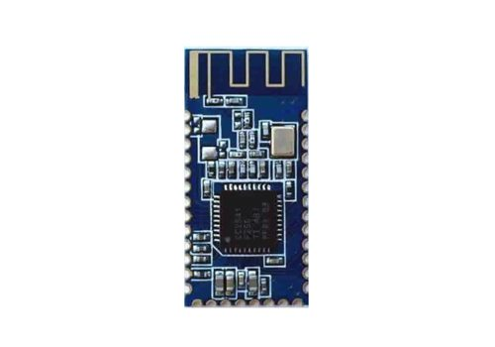

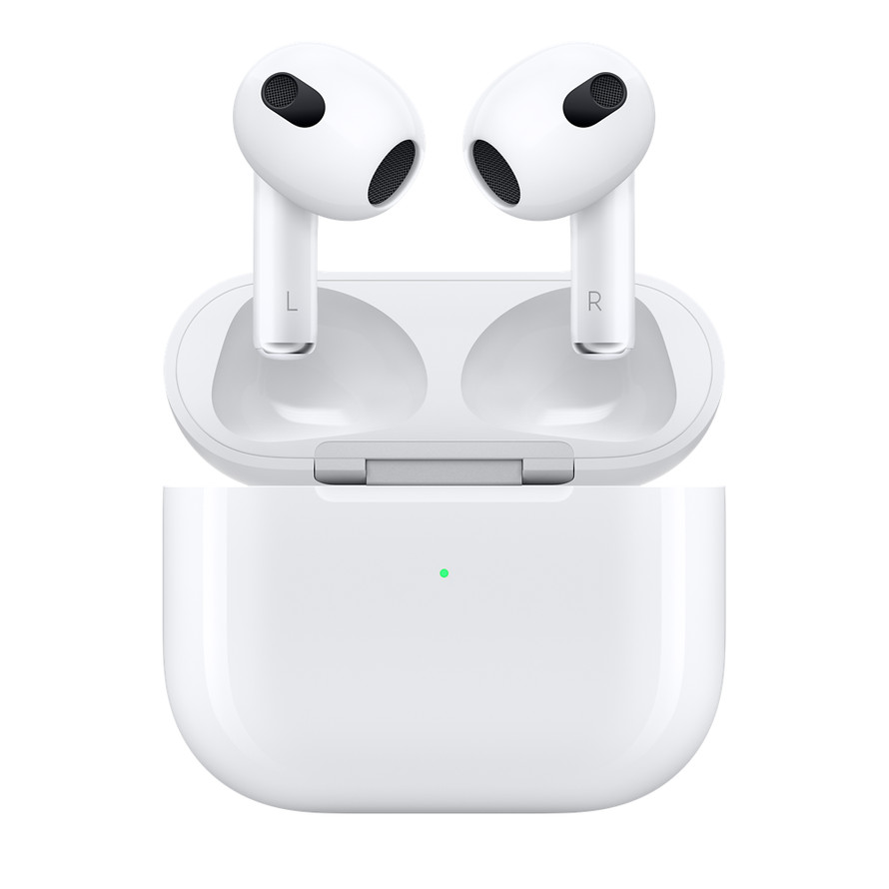
Bluetooth Devices
Notes:
Headset: https://a.co/d/6SUfdrY
BLE Arduino: https://store-usa.arduino.cc/products/bluetooth-low-energy-4-0-module-hm-10

Slide 9
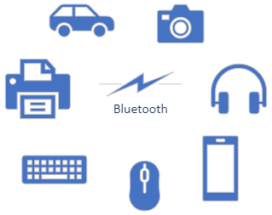
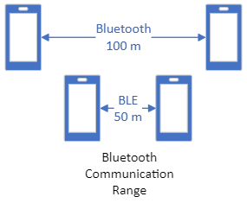
Bluetooth
Below Wi-Fi, most prevalent wireless communication protocol
Examples: headphones, keyboards, vehicles, phones
BLE (Bluetooth Low Energy)
Lower range
Higher transfer rate
Lower latency, lag, and power consumption

Slide 10
Bluetooth Vulnerabilities
Attacks – Mitigations: security updates
Bluejacking – send out message to nearby phones (nuisance) [14]
Bluesnarfing - pushes a “get” request for files with a known filename, even for phones in non-discoverable mode [20]
Requires the 48-bit Bluetooth device name
Bluebugging (Pairing Vulnerabilities) can control phone including phone, SMS messages and microphone
Key negotiation downgrade: BIAS [18] and Key Negotiation of Bluetooth (KNOB) [19]
Bluesmack [20] - crafted oversized packets to crash the device or create a DoS attack
Additional mitigations:
Tracking – turn off BT
Limit connectivity, Limit app permissions
Notes:
Bluebugging attacker executes a specific command in the parser that allows full access to a victim’s phone to make phone calls, a phone acting as a bug, hence the name. Bluebugging can also send short message service (SMS) texts, read SMS messages stored on the phone, read and write contact list entries, alter phone service parameters, connect to the Internet, forward calls, and more

Slide 11

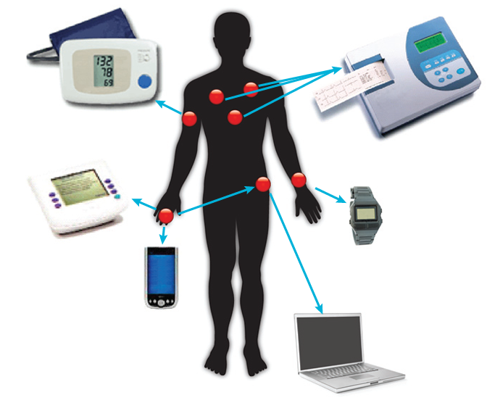
Zigbee
Notes:
Medical: https://www.science.smith.edu/~jcardell/Courses/EGR328/Readings/Zigbee&HealthCare.pdf

Slide 12
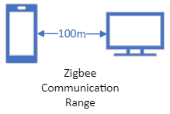
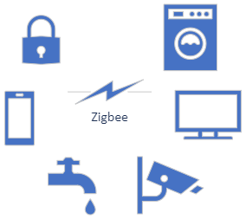
Zigbee
Low-cost, low-power wireless used to monitor and manage devices including:
IoT devices
Automated sensors
Industrial automation
Healthcare (pacemakers, insulin pumps)
Radio frequency (2.4 GHz) with a range of about 10-100m
AES 128-bit encryption algorithm
Notes:
10-100 m comms

Slide 13
Zigbee Vulnerabilities
Symmetric encryption key sniffing [24-25]
DoS
End-device sabotage attack – drain energy and cause power failures [25-26]
Collision avoidance – (CSMA/CA) [23]
Replay attack – affect physical devices [26-27]
Mitigations:
Do not broadcast keys unencrypted over network
Add separate encryption key
Rotate keys + secure key management
Rate limiting (frequency and volume of polling requests)
Cyber best practices
More mitigations in [28]
Notes:
Attacks mentioned in [28]
Communication interruption
Disconnection
Key leakage
Improper integrity check
Truncated packets

Slide 14
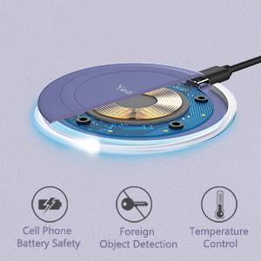
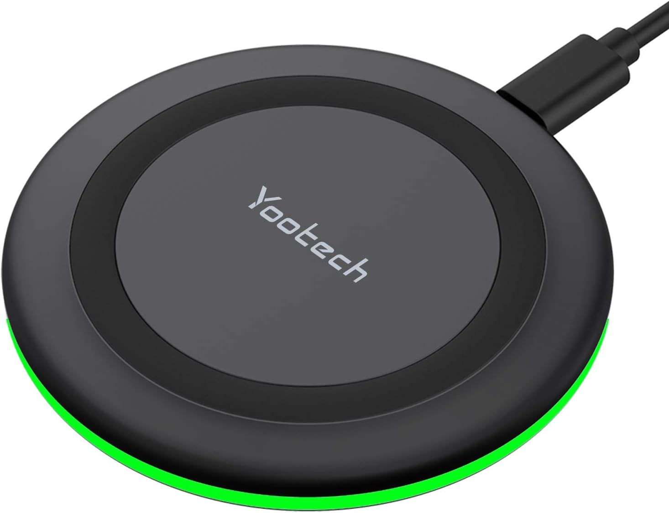
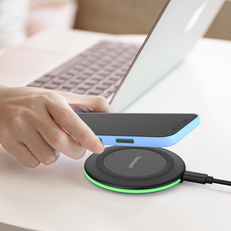
Qi Wireless Charging Pad

Slide 15
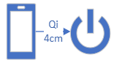
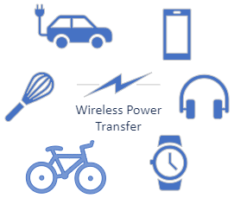
Qi
Used to charge handheld devices, home appliances, and other small electronics
Standard maintained through the Wireless Power Consortium
Current version 1.3. Version 2.0 specs behind paywall.
Frequently available for use at:
Airports
Restaurants
Shopping malls

Slide 16
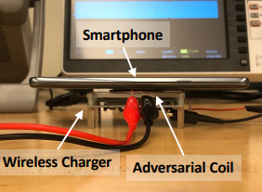
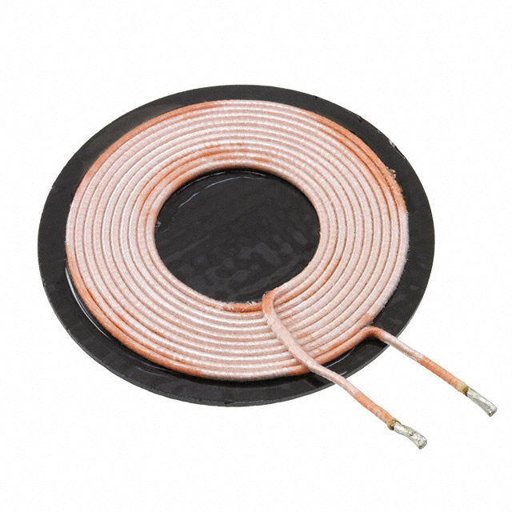
Qi Vulnerabilities
Hijacking Attack [23,39]
Denial of Charge
Slow or excessive charging (explosion)
Eavesdropping Attack
Able to determine / create signatures for active apps running:
EX: Clash of Clans is running in the background
Using YouTube
Receiving a call or a text message
Device tracking [32-38]
Use Qi identifier to track individual device
Create location-specific ads
Subtle differences at the manufacturer-level (QID) [35-38]
Recommended mitigations [67-69] (not in protocol):
Sliding window-based anomaly detection mechanisms
Dynamic switching of amplitude/frequency to mitigate eavesdropping attacks
Encrypting information (device ID, charging state, control info) [29,66]

Slide 17
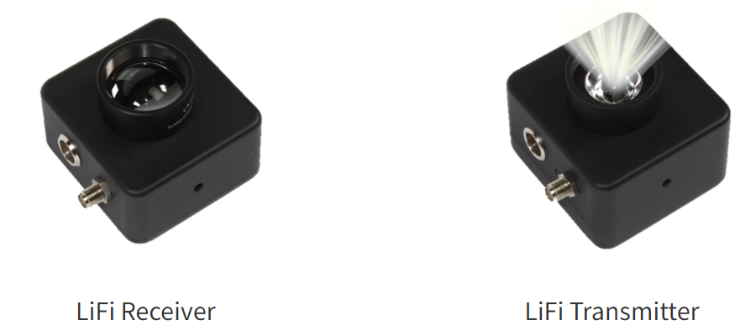
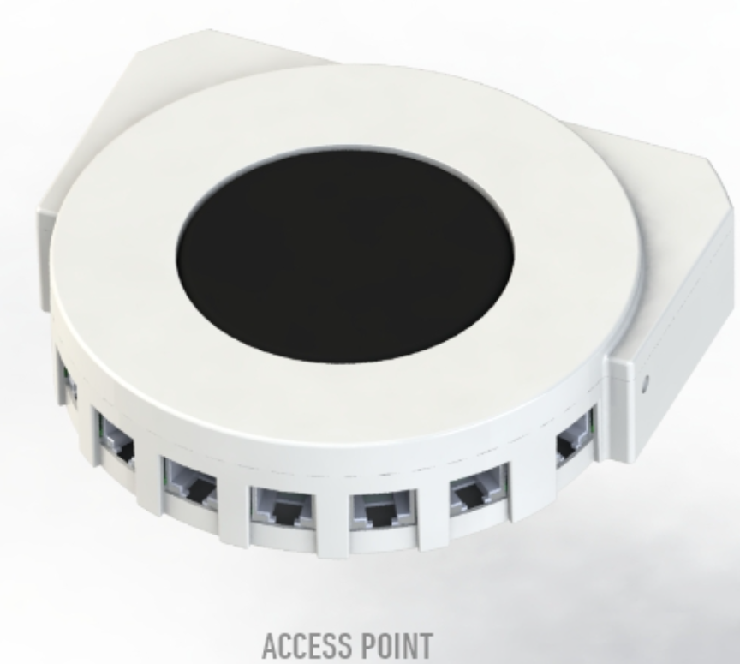

Li-Fi
Notes:
R/Tx: https://www.hyperiontechs.com/product-category/devtools/lifi-devtools/
Receiver dongle: https://lifi.co/lifi-product/lifimax-flex/
Access point: https://terraferma.com/products/industrial-lifi-access-point-ap/#specs

Slide 18

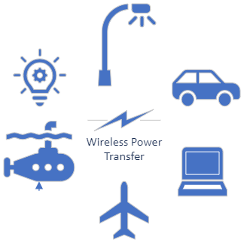
Li-Fi
Newer / faster wireless transmission than Wi-Fi
Uses light and a transceiver for communication
Bidirectional, Full Duplex, High Speed, IP Addresses
Uses include low-infrastructure communications
Disaster relief (FEMA, IEEE MOVE trucks?)
Car headlights
Airplane internet access
Underwater applications
No RF – harder to detect
Notes:
Use this as slide setup example

Slide 19
Li-Fi Vulnerabilities
Transmission-level attacks [40-42]:
Interference / DoS (physical block or flood with light)
System fraud because of poor protections on the Li-Fi tags [45-46]
Eavesdropping
A gap between a door and the floor
Others in same area with receiver in confined space
Mitigations:
Physically shield light / limit access
Dynamic ID updates on Li-Fi dongles [70]
Authentication and handover protocols [71]
Notes:
Interference – physical block or flood with light
Processing and Transmission Level Attacks, Input Level Attacks, Back-End Attack (especially for DoS) and Enrollment Attack. Transmission-level attack include eavesdropping and interference [40], [41]

Slide 20
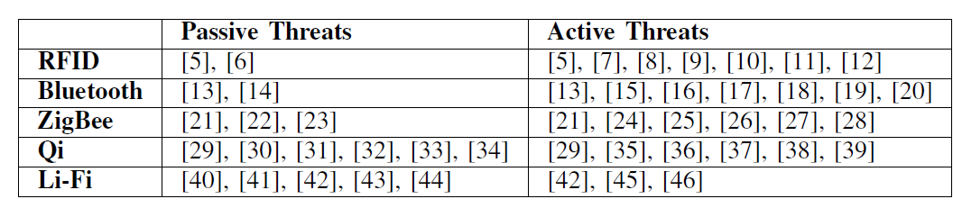
Survey Paper
RFID
Close range wireless communication
Tracking application
Bluetooth
IoT Communication
Many patched vulnerabilities
ZigBee
Medium-Close range wireless communication
Smart home application: Low power, long life
Qi
Charging protocol
Most applications include small handheld devices
Li-Fi
Light and transceiver as a form of communication
Similar application to WiFi

Slide 21
Conclusion
Each technology has use case; strengths and weaknesses
Need to be aware before and during deployment of side-channel vulnerabilities and mitigations
Repeated advice across protocols is…
Use cybersecurity best practices:
Install patches / updates
Secure key management
Security audits
Technology-specific best practices

Slide 22

Questions?
Dr. Shannon Beck
Shannon.Beck@afacademy.af.edu
Dept of Computer and Cyber Sciences

